Slide 1
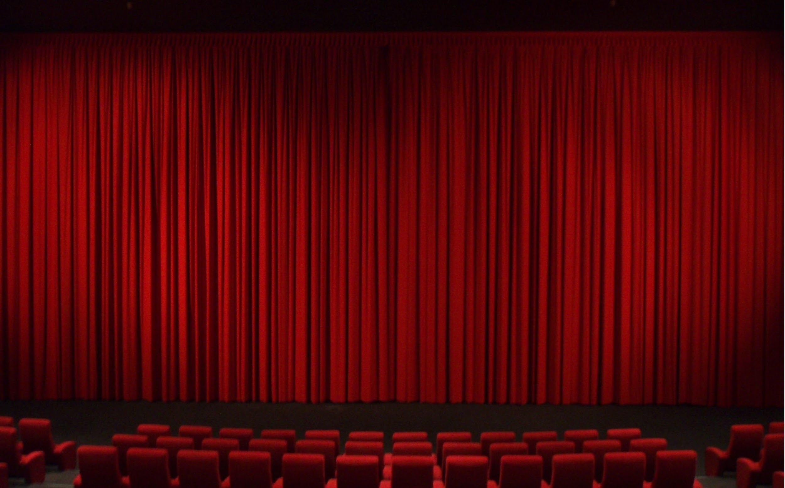
Movie Roulette

Slide 2
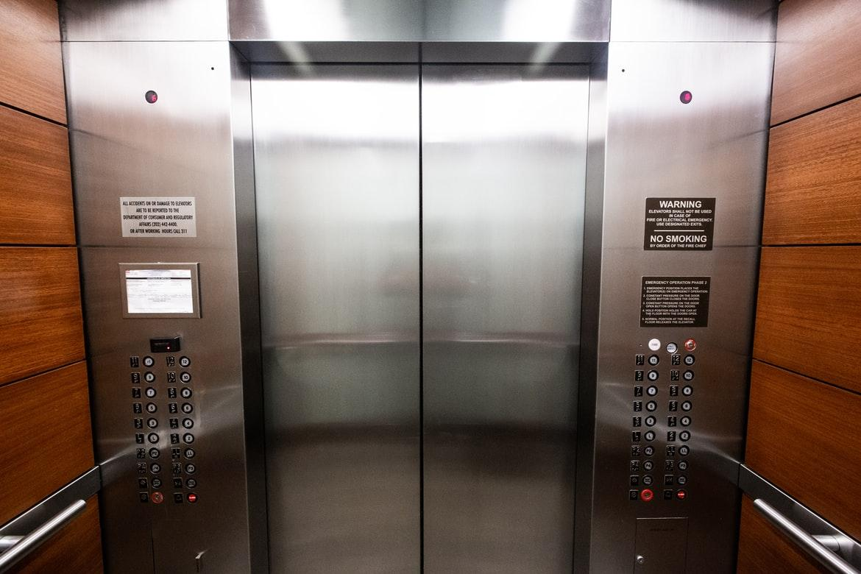
Elevator pitch
Easy, concise design.
A quick way to find films.
It is an easy way to expand your film horizon.

Slide 3

Concept
Movie Roulette is an app that populates movies based on genre selection.
The movies that are populated will be the top 10 of that given time.
This app is excellent for those who are not looking for specific movie titles.

Slide 4

Process
Materialize/Google fonts (for design)
TMDB (for movie data)
Youtube API (for trailers)

Slide 5
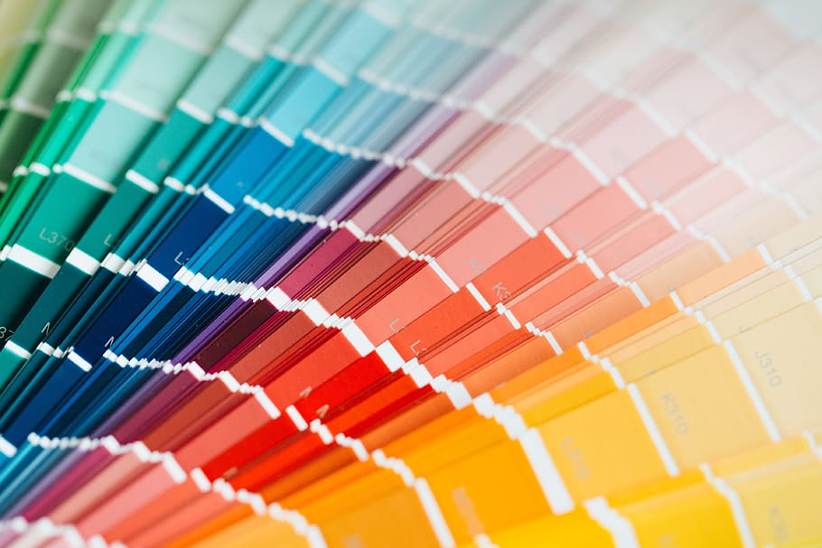
CSS Challenges
Comfort with a new framework
Mobile layout

Slide 6

Script Challenges
Discovering how to make the cards interactable
Figuring out how to make the two APIs work with each other for separate information

Slide 7

API Challenges
Quota restrictions
Difficulty pulling trailer information from the API

Slide 8

Demo

Slide 9
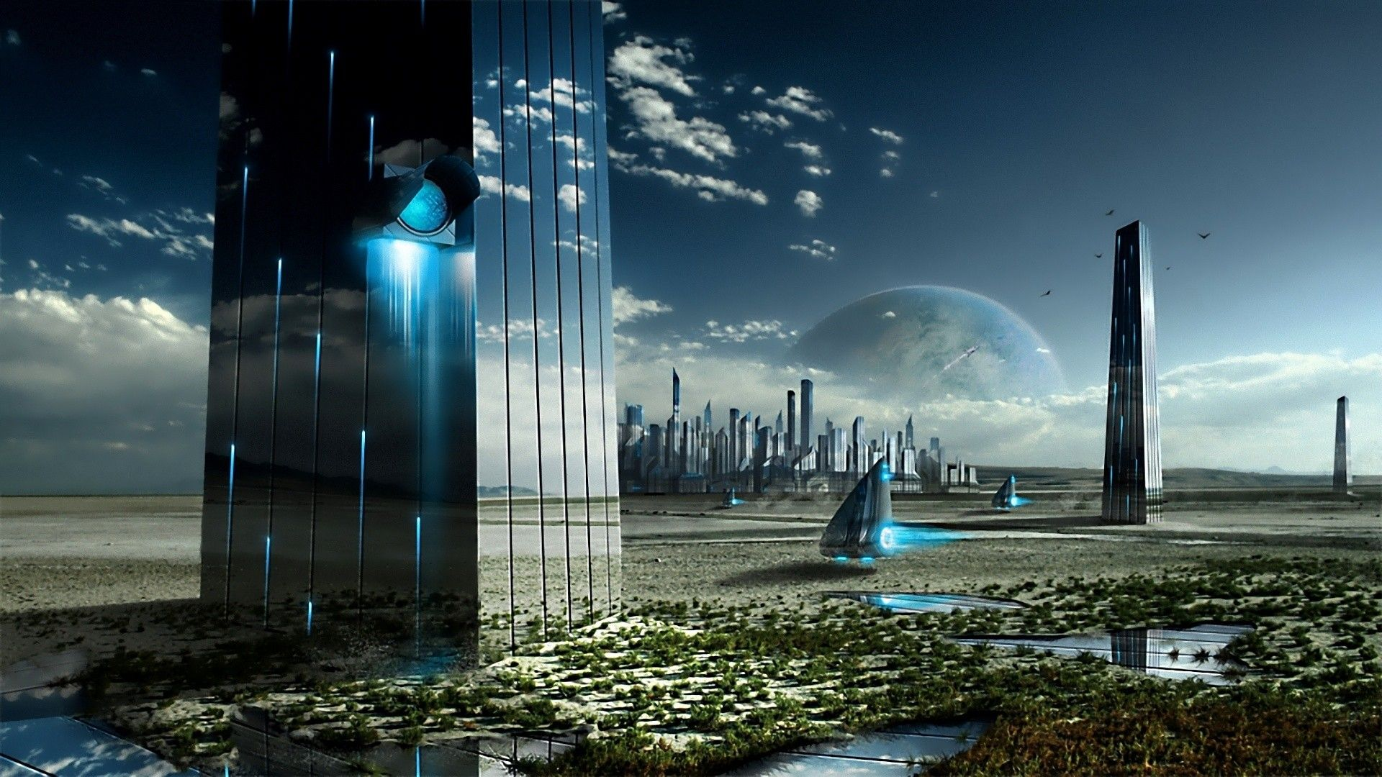
Future Development
Widen the scope of each genres ranked movies.
Allow the movies to be randomized rather than top 10.
Incorporation of modals rather than redirecting to another site.

